Slide 1
Financial Aid
Carly Kestner
Director of Financial Aid

Slide 2
Financial Aid Process
Carly Kestner

Slide 3
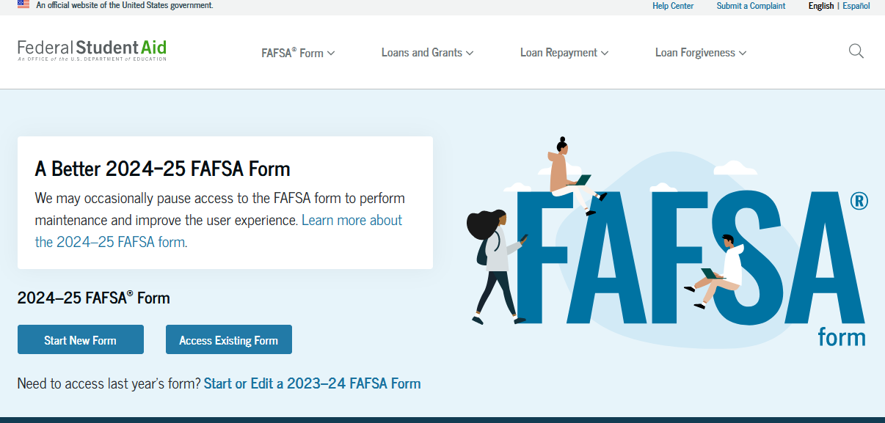
Applying for Financial Aid
File Your FAFSA BY MARCH 1ST
Applying for Federal Aid and WV Higher Education Grant

Slide 4
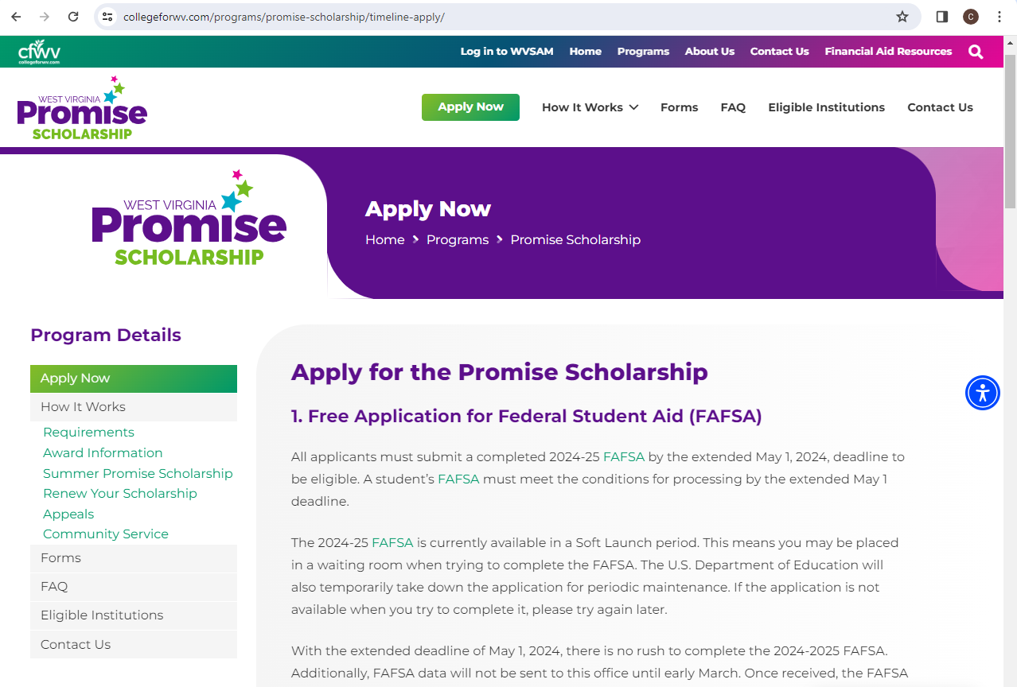
Applying for Financial Aid
Apply by MARCH 1ST
Applying for WV Promise

Slide 5
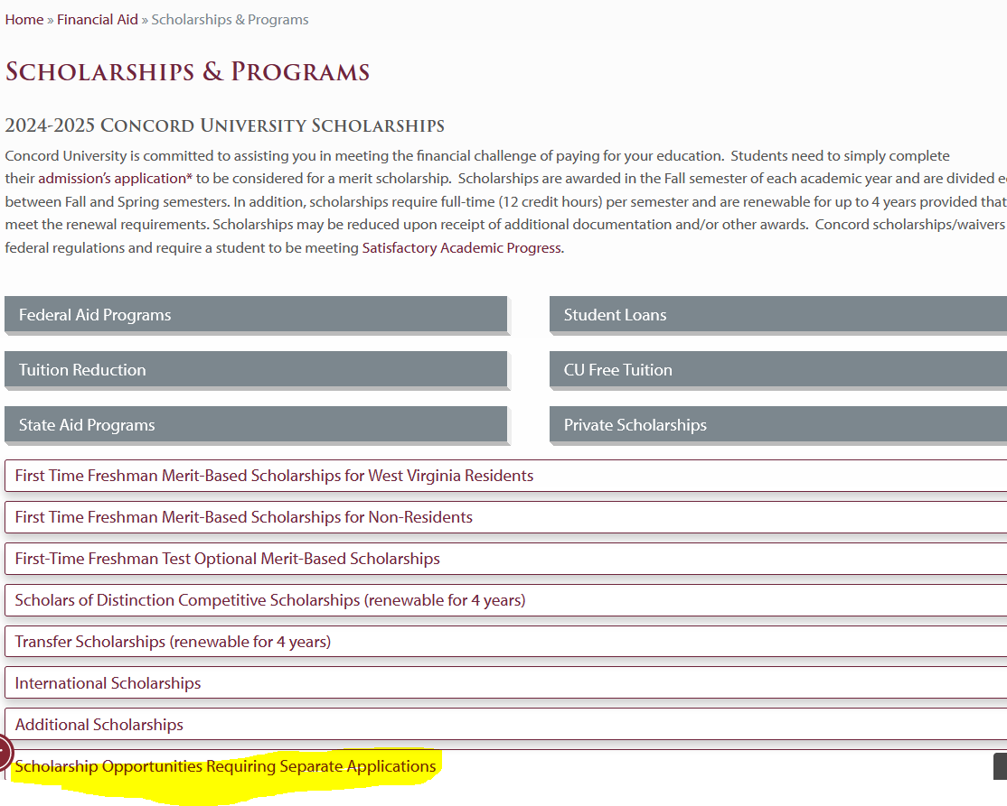
Additional Scholarship Opportunities at CU
https://www.concord.edu/financial-aid/scholarships-programs
Additional Scholarship Opportunities

Slide 6
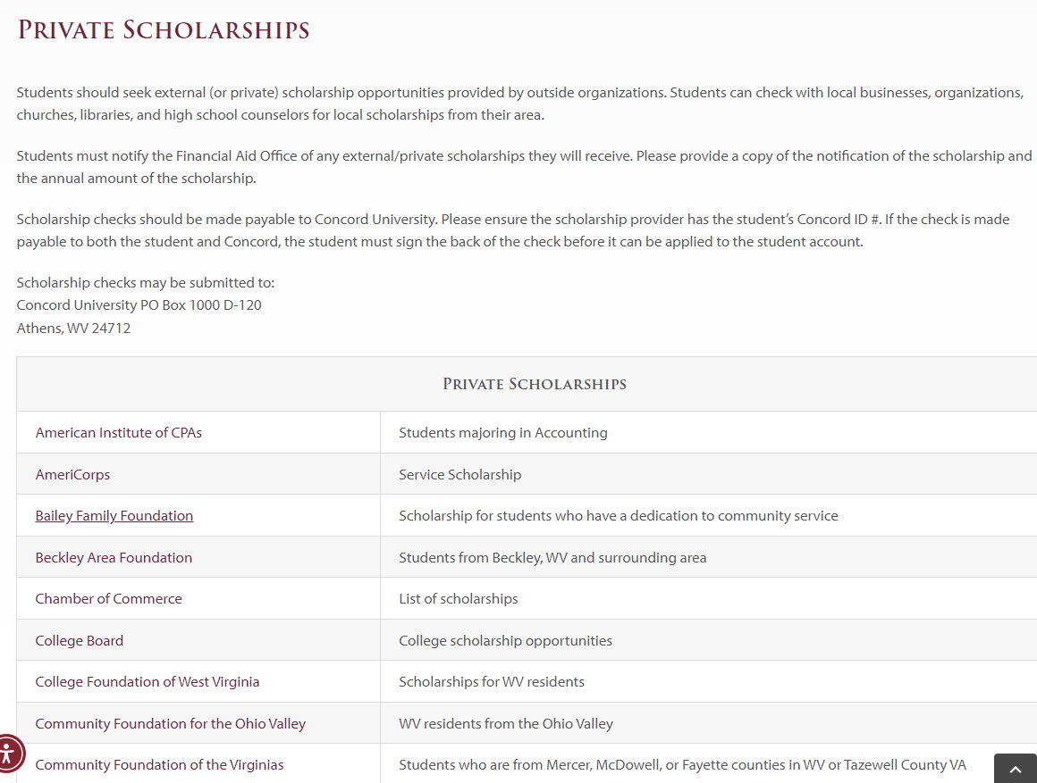
Additional Scholarship Opportunities
https://www.concord.edu/financial-aid/scholarships-programs/private-scholarships
Additional Scholarship Opportunities

Slide 7
Additional Scholarship Opportunities
Department of Rehabilitative Services
Veteran’s Benefits
High School
Rotary
Employer
Additional Scholarship Opportunities

Slide 8
Additional Scholarship Notification
Please inform the Financial Aid Office of any outside scholarships received.
Provide copy of the certificate received or a list of donors with annual amounts
Checks can be forwarded to:
Concord University
PO Box 1000 D-120
Athens, WV 24712
Additional Scholarship Opportunities

Slide 9
Financial Aid Process
Types of Aid Available
Scholarships
Grants
Loans
Federal Work-Study

Slide 10
Loan Limits
Annual Loan Limits Aggregate Limits
Freshman - $5,500 $31,000 for Dependent
Sophomore - $6,500 $57,500 for Independent
Junior/Senior - $7,500
Repayment does not begin until 6 months after the student drops below 6 credit hours.
Carly Kestner

Slide 11
Student loans
Accepting Your Student Loan
Student must actively accept student loans through MyConcordU
1. Log in
2. Click on the Financial Aid Tab
3. Click on Award
4. Click on Award by Aid Year
5. Select 2024-2025 aid year
6. Click on Accept Award Offer Tab
7. Submit Decision
Next, students must complete the Entrance Counseling and MPN (Master Promissory Note) at www.studentaid.gov

Slide 12
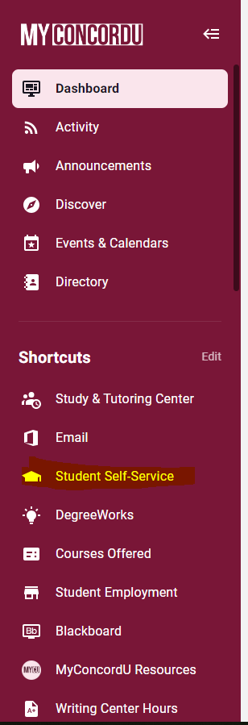
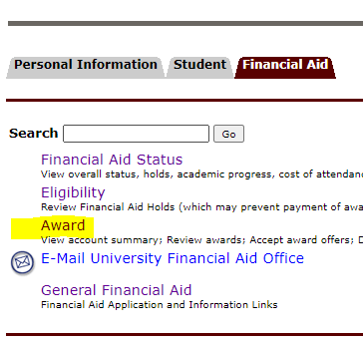
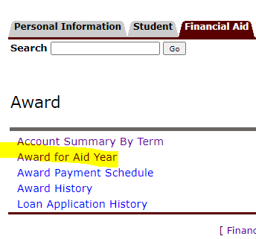
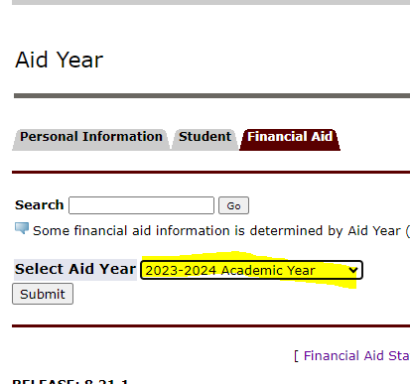
MyConcordU
Accepting Your Student Loan

Slide 13
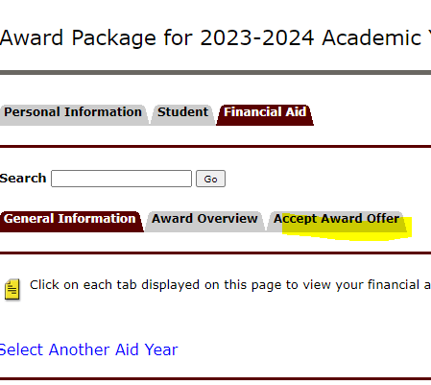
MyConcordU
Accepting Your Student Loan

Slide 14
Federal Work-Study
Employment during school
Receive paycheck every two weeks for the hours worked
Min pay $10.75 per hour
Does not apply towards direct charges
Apply for jobs at https://concord.joinhandshake.com/edu
Funding available even if a student is not awarded or eligible for federal work-study
.

Slide 15
Parent Plus Loan
Parent applies at www.studentaid.gov
Approval is credit based
Approved:
Parent Master Promissory Note
Can borrow up to the student’s cost of attendance
Denied:
Student will be offered additional unsubsidized loan funds (up to $4000)
.

Slide 16
Private Educational Loan
Many times requires a co-borrower
Comparison shopping is critical
School certifies the loan

Slide 17
Additional Requirements
Notifications are sent requesting missing documents. This requests will be sent alternating between the mail and electronically. Please submit any requested documentation as soon as possible.
Many of the requested documents are required for disbursement and failure to submit will mean this aid cannot be used to offset your direct charges.
Go to your MyConcordU to view is you have missing requirements:
Student Self-Service
Financial Aid
Eligibility
Student Requirements
Carly Kestner

Slide 18
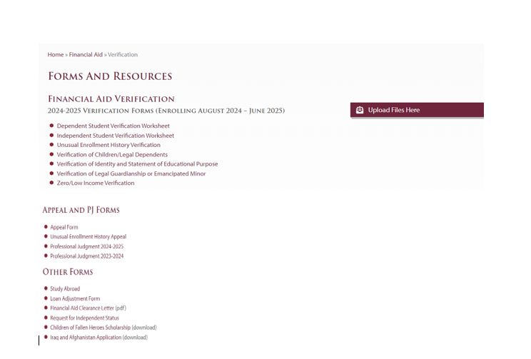
Additional Requirements
Forms and Resources: https://www.concord.edu/financial-aid/verification

Slide 19
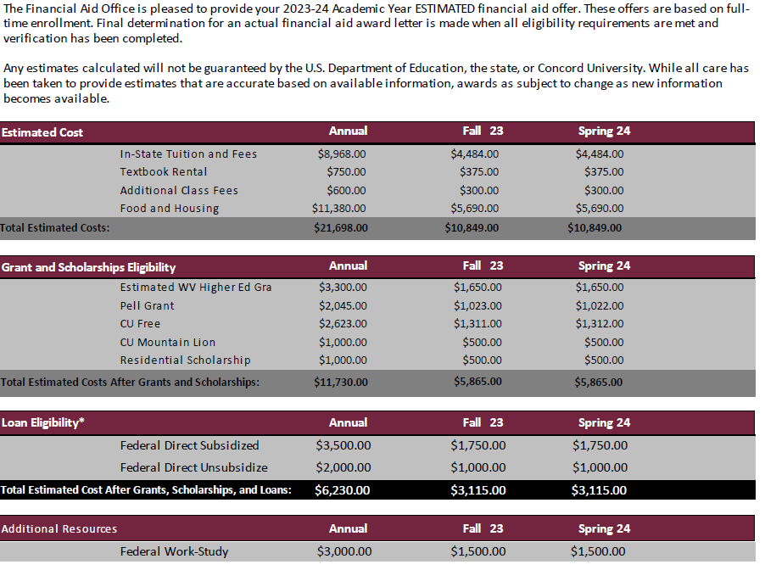
Financial Aid Award Offer
Understanding the Award Letter

Slide 20
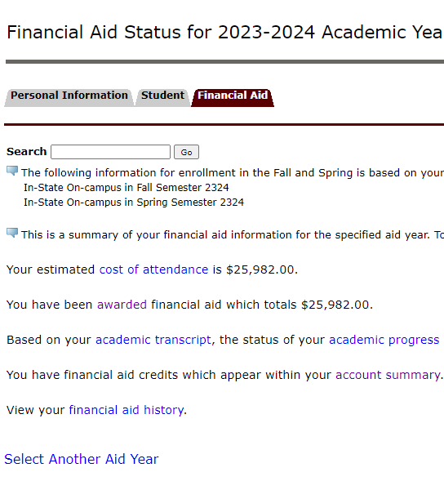
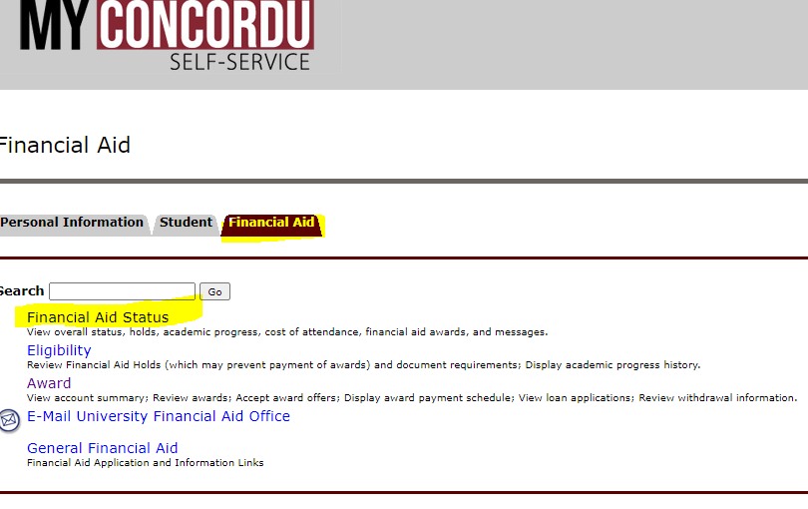
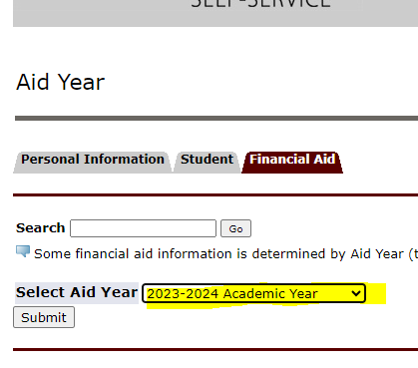
MyConcordU
Award Overview

Slide 21
Renewal Requirements
When awarded scholarships be aware of the renewal requirements, GPA and/or hours requirements!!!
WV Promise Scholarship – 30 earned hours, 2.75 after first year, 3.0 each year after
WV Higher Education Grant- 24 earned hours, 2.0 GPA
Most Concord Academic Awards- 24 earned hours, 2.5 GPA

Slide 22
Satisfactory Academic Progress
Students must be making satisfactory progress towards obtaining the degree.
Three standards a student must meet after each semester of enrollment:
1) GPA
2) Progression Rate (hours earned/hours attempted)
3) Maximum Time Frame
Policy is located at on our website at https://www.concord.edu/financial-aid/satisfactory-academic-progress

Slide 23
Financial Aid Disbursement
Must confirm your attendance with Student Accounts Office
Anticipates full-time enrollment
Completed all Financial Aid Requirements

Slide 24
Professional Judgment
Provisionally Independent Students- must complete a Request for Independent Status, and documentation of the unusual circumstances of why parental information cannot be provided.
Changes that cannot be reported on the FAFSA such as:
Loss of employment
Divorce/Separation
Medical Expenses
Must complete the Professional Judgment Form, written explanation, and documentation of the special circumstances.

Slide 25
Annual Checklist
Complete the FAFSA, opens October 1st
Complete the Foundation Scholarship Application opens by January 1st
Check your email and MyConcordU to determine if you have any requirements to complete or any financial aid issues
Returning Student Award Letters emailed mid to late June
Plan if you have a remaining balance

Slide 26
Carly Kestner
Financial Aid Office
O | 304-384-6069
E | financialaid@concord.edu
concord.edu/financial-aid
THANK YOU FOR ATTENDING THIS PRESENTATION!

