Slide 1


Slide 2

What is Practicum?

Slide 3
Practicum is considered to be the signature pedagogy in social work education
This means that in the field of social work, field is where to get to put all facets of your education and training together (theory and practice). Field Education is translating pedagogy into practice.

Slide 4
BSW Practicum Application:
https://www.concord.edu/academics/college-of-professional-and-liberal-studies/department-of-social-work-and-sociology/field-education
Practicum Application Due Dates:
Spring: October 1
Summer I and II: March 1
Fall: April 1

Slide 5
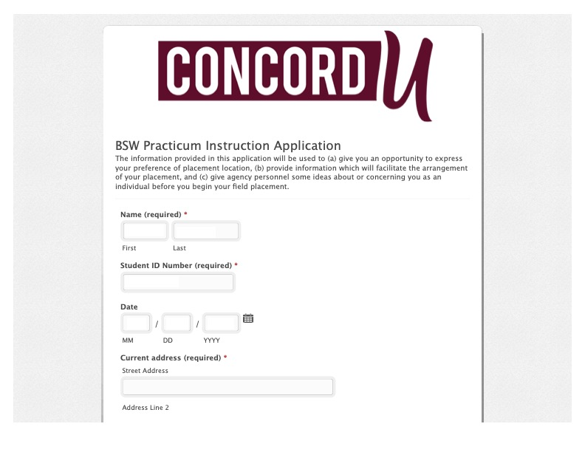
BSW Practicum Application:

Slide 6
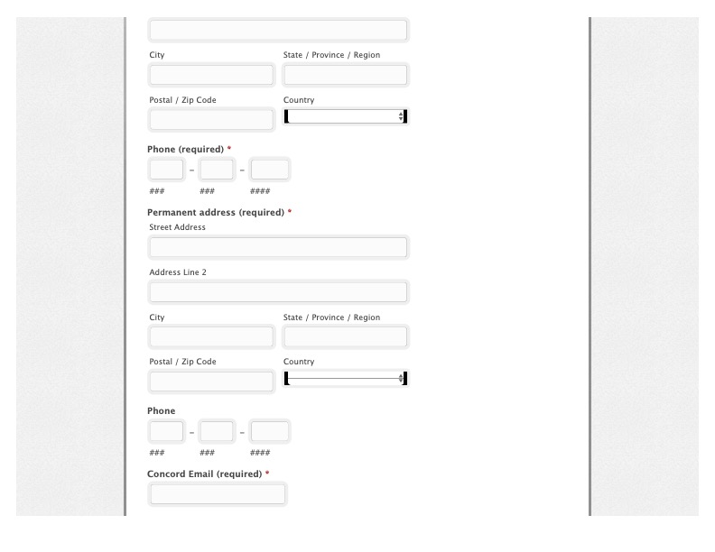
BSW Practicum Application Continued:

Slide 7
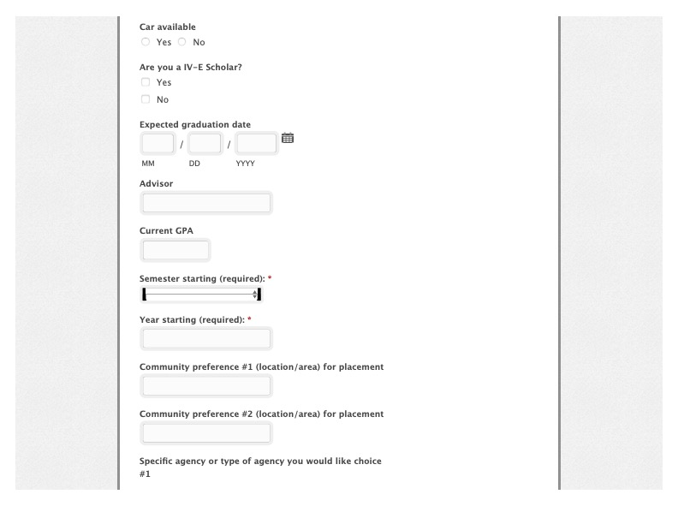
BSW Practicum Application Continued:

Slide 8
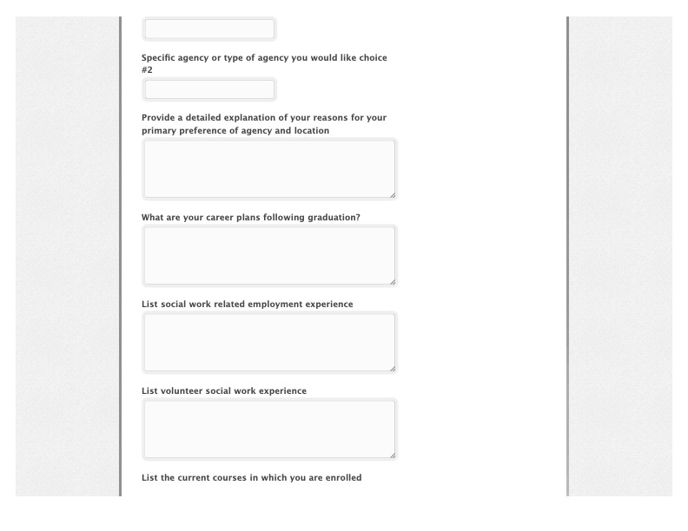
BSW Practicum Application Continued:

Slide 9
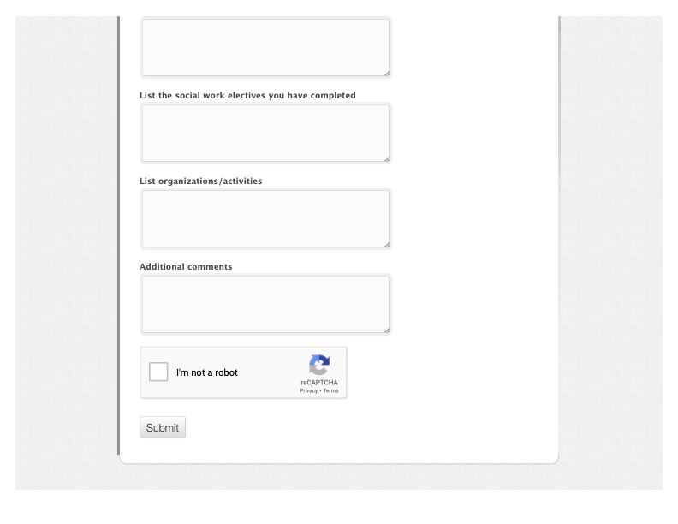
BSW Practicum Application Continued:

Slide 10
BSW Practicum Application:
Your application will be prepopulated with your name, your CU ID number, and the date that you complete it.
You will list your current address (address at CU) and your permanent address (home address) on the application.
Please also list your cell phone number on the application. If there are any questions, I will utilize this number to contact you.
Next, you will list your CU email address.
You will choose “yes or no” to the question of whether or not you have a vehicle available for use.
Next, answer ”yes or no” to whether or not you are a IV-E Scholarship recipient from the WV DHHR.
You will then list your expected graduation date, advisor name, and current GPA.

Slide 11
BSW Practicum Application Continued:
You will then put in the Semester you will be starting practicum.
The next question is the year that you will begin practicum.
Please fill in a Community Preference 1 and an Agency Preference 1 in each field for the agency and location that is your first choice for practicum.
List a 2nd agency and community for your secondary choice for practicum.
Please complete the field asking why you requested your primary agency and its location.
Complete the career plans field, as well as the social work related employment experience and volunteer experience fields.
List your current courses and your social work electives completed to date.
Finally, list your organizations that you are involved with and any additional comments that you might need to make.
When you submit the application, it will be sent immediately to the Practicum Director.

Slide 12
Your field agency will not be chosen and assigned for you.
The reason is that your field practicum agencies should be chosen by you, the student, for your personalized career goals. This agency should be chosen by thinking about what career path in social work you are interested in being employed in after your graduation.
The Director of Practicum Education, is always happy to help you if you are unable to locate a practicum agency. However, please remember that students outside the state of WV may have to provide potential agencies for us to contact because the practicum director is often completely unfamiliar with the areas in which you are searching and what agencies exist there.

Slide 13
When Choosing an Agency:
The agency that you choose to complete your BSW Practicum within must have a BSW/MSW Employee with at least two (2) years of professional experience to supervise your Practicum. This individual will work directly with you in your practicum to understand how the tasks you are doing fit into the Nine (9) Social Work Competencies and their respective practice behaviors.

Slide 14
IV E Scholarship Recipients:
Must complete their practicums within a West Virginia DHHR or WV DOHS Office. This is stipulated in your contract.

Slide 15
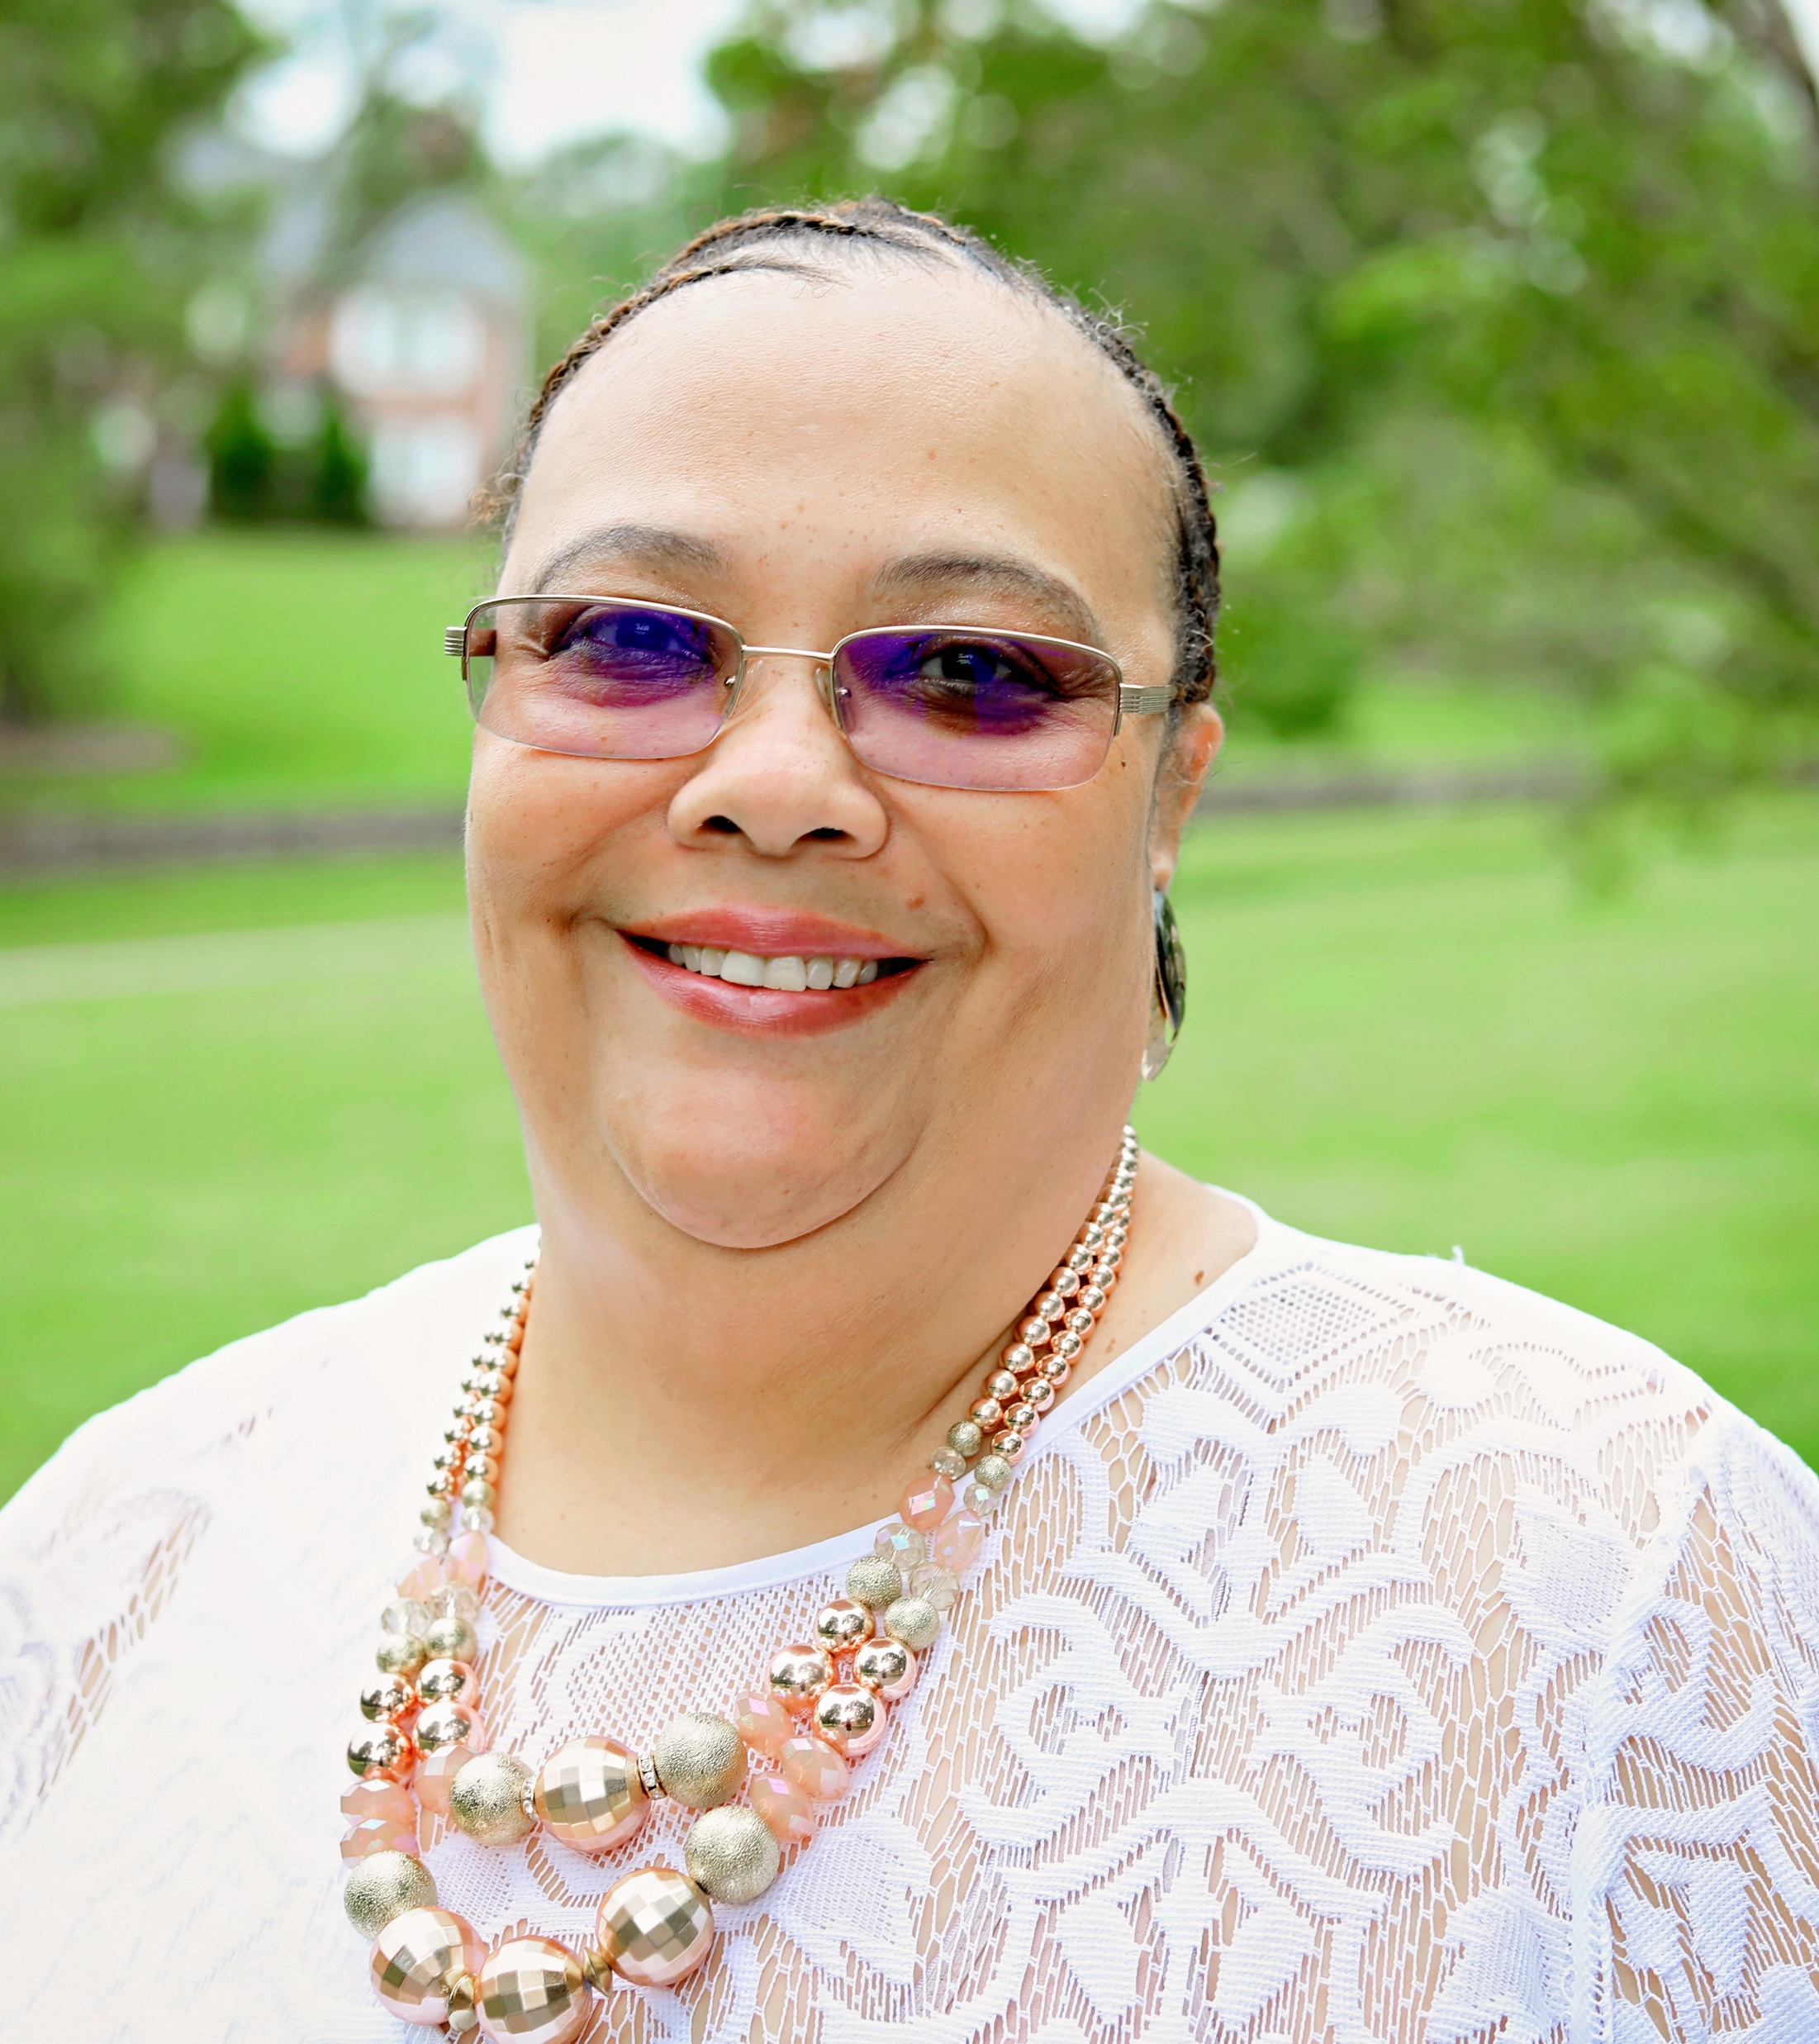
What is does the Practicum Director do?
The Practicum Director oversees the Field Practicum Programs. This is the individual who will work with a designated individual at your chosen agency to complete the paperwork and process to have an agency approved as a field practicum site.

Slide 16
What is a Practicum Instructor?
One requirement of practicum is that you must have an individual with an BSW or MSW Degree with at least two years of professional practice to oversee your practicum placement. This individual is referred to as your Practicum Instructor. They should be employed by your chosen agency and will work directly with you in your practicum to understand how the tasks you are doing fit into the Nine (9) Social Work Competencies and their respective practice behaviors.
This will also be the individual who will work with you and your faculty liaison (Professor Hoke) to complete required assignments such as completing your learning contract and varied assignments that include your competency thesis.

Slide 17
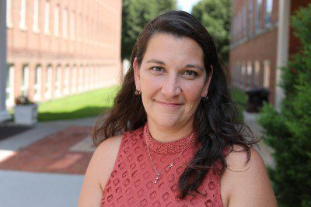
What is a faculty liaison?
This is the professor (Professor Hoke) assigned to teach your practicum course. While you are completing hours for your practicum, you will also be assigned to a Class within which you will complete assignments and meet synchronously as a class.

Slide 18
Who decides the number of hours I must work weekly?
The number of hours required for your BSW Practicums are 40 hours per week or whatever your chosen agency determines to be “full-time.” You must continue to “work” a full-time schedule the entire semester of your practicum.
The total number of hours required are determined by the Council on Social Work Education (CSWE); the accrediting body of all Social Work educational programs.

Slide 19
I would like to be licensed as a social worker in my state.
Licensing requirements are controlled at the state level by social work licensure boards and requirements differ from state to state. States also have different types of licenses depending on educational and work experience (ex. LSW, LGSW, LCSW, LICSW).
Please review, early in the process of practicum, the state licensing requirements that are appropriate for you.

Slide 20
Examples of field practicum sites:
Can be found under “Practicum Education Placement Organizations” found here (https://www.concord.edu/academics/college-of-professional-and-liberal-studies/department-of-social-work-and-sociology/field-education).

Slide 21
Concord’s Director of Practicum Education can be reached by utilizing the following contact information:
Terri H. Philpott Ph.D. Candidate, MSW, ACSW, LCSW
You may reach her by calling: 304.384.5282 or by emailing her at tphilpott@concord.edu.

