Slide 1
PAST, PRESENT, and FUTURE of Teacher Education at CU
Joint collaboration with C-PAC, C-TEC, and CU

Slide 2
Today’s Agenda
Welcome and introductions (How many years have you worked in the field of education?)
Updates – where we started, where we’ve been, and where we’re headed
Round table discussions
Lunch
Co-constructing employer satisfaction survey for graduates of advanced programs
Leadership
Reading Specialist
Special Education

Slide 3
Where we started….

Slide 4
Where we were….

Slide 5
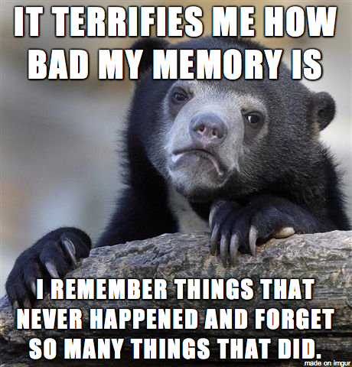
Where we have been….
Adopted and implemented the Educator Disposition Assessment and process
Adopted and implemented ProEthica
Developed professional seminars being implemented this semester
Implemented leveled clinical experiences with components of Student Teaching Observation Tool
Submitted our self study report to our accreditation body
Developed and implemented a MOU between CU and WV Careers in Education program
Castlebranch

Slide 6
Where we are…
Program | Undergrad | MAT | Total
Art | 1 | 5 | 6
Biology | N/A | 4 | 4
Business | N/A | 5 | 5
Chemistry | N/A | 2 | 2
Elementary | 158 | N/A | 158
English | 34 | 3 | 37
Gen Science | 7 | 0 | 7
Math | 3 | 3 | 6
Music | 15 | 0 | 15
PE/Wellness | 26 | 6 | 32
Social Studies | 47 | 3 | 50
SPED | 18 | N/A | 18
 | MED | Cert Only | Total
EDEL | 25 | 12 | 37
RDNG | 21 | 0 | 21
SPED | 9 | 0 | 9
Total | 55 | 12 | 67

Slide 7
Where we are…..
31 student teachers fall 2019 – 9 who are graduate students
11 University supervisors – 7 who are fulltime faculty
Working on year-long residency plans
Preparing for accreditation visit – PLEASE SAVE THE DATE: April 26-27

Slide 8
Where we need to go….
More work
Review how our candidates have performed on assessment measures
Provide feedback regarding what you observe of our candidates in the field
Round table discussion providing suggestions for how to assist our candidates’ growth

