Slide 1
Stalking 101
Presented by:
Nicole Massey, RBA - Director of Community Education
Serrell Garee - Sexual Assault Victim Advocate
Family Refuge Center

Slide 2
—Molly Harper
“I think the very word stalking implies that you're not supposed to like it. Otherwise, it would be called 'fluffy harmless observation time'.”

Slide 3
Table of Contents
1
2
3
Family Refuge Center
Stalking
Campus Related Stalking
4
5
6
Tech Related Stalking
The Intersection Between Stalking and Sexual Violence
Wrap Up

Slide 4

1
Family Refuge Center

Slide 5
Family Refuge Center
Who We Are:
Family Refuge Center is a community-based domestic violence project committed to ending physical, sexual, and emotional abuse in families. We encourage and promote healthy family life based on mutual respect and support for all family members.
Family Refuge Center is a “dual-program” serving Pocahontas, Greenbrier, Monroe, and Mercer Counties in southeast West Virginia. This means that FRC serves as both a domestic violence program and rape crisis center.
Notes:
There are 6 dual programs throughout the state; others are “stand-alone” programs, serving only victims of domestic violence or victims of sexual assault.
In Mercer County, we serve solely as a Rape Crisis Center. SAFE (Stop Abusive Family Environments) provides domestic violence services in Mercer County.

Slide 6
Family Refuge Center
Services We Offer:
Shelter Services: FRC has a 16-bed emergency shelter. Our shelter is for victims of domestic violence, sexual violence, elder abuse, stalking or human trafficking who are in fear for their safety or the safety of their children.
Counseling: FRC contracts with a local therapist to provide counseling services to all clients being served by the agency.
Notes:
Shelter: The average length of stay in shelter is 10-12 weeks. While in shelter; all food and personal hygiene items are provided by the agency. Advocates in shelter work to move the victims to feelings of safety, physical safety, and independent living.

Slide 7
Advocacy
What is an Advocate?
Notes:
When you hear the word advocate what do you think it means? An advocate is someone who helps people !

Slide 8

What our advocates do:
Medical Accompaniment and Advocacy
Comprehensive case management
Economic Justice Advocacy
Civil Legal Advocacy
Advocacy within the Criminal Justice System
Safety Planning
Notes:
Medical Accompaniment I respond to hospital calls to support the client through the forensic exam process when dealing with assault. I can also provide transport to medical appointments as needed. In case management, I assess your needs and work with you to provide you with the resources or referrals you may need. Each person and situation is unique and requires different services, this is an ongoing process and I help to support the client through this every step of the way. Economic Advocacy: If the client has financial needs I can assist by providing emergency funds, as well as help coordinate with employment services available in our county. I provide criminal advocacy by accompanying clients to hearings as well as assist the client by coordinating with the court advocates. This process can be confusing but we can help you navigate this! In Civil Legal advocacy I can refer to legal aid, as well as accompany you to hearings and be there as support. Safety planning: If you are trying to leave a violent situation we can work together to develop a plan for you to be able to leave safely.

Slide 9
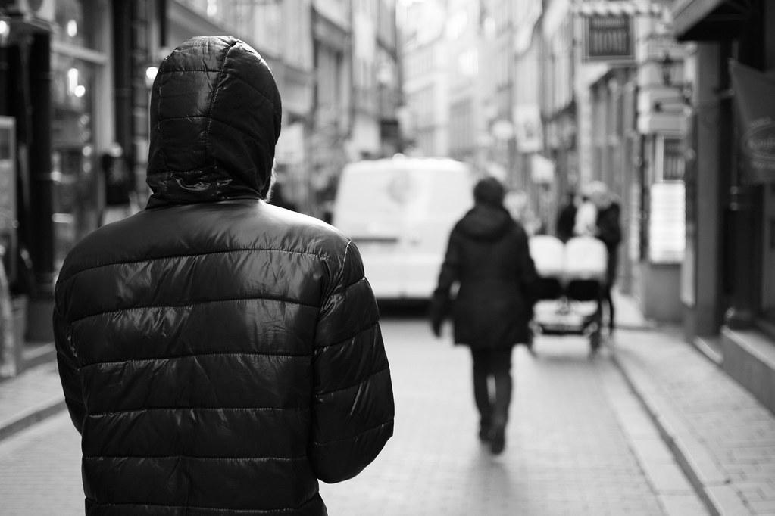
2
Stalking

Slide 10
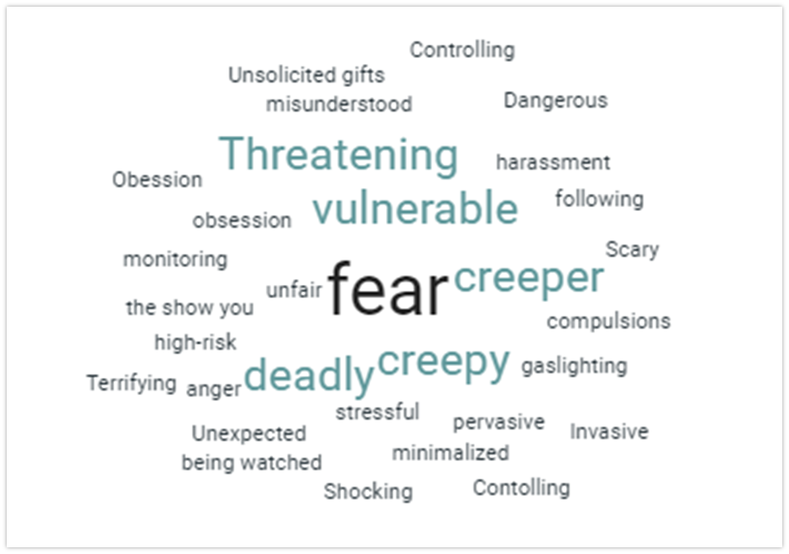
Word Association
What are some words that come to mind when you think of stalking?

Slide 11
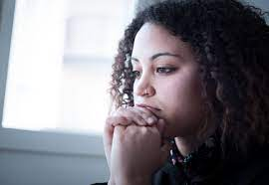
What is Stalking?
Stalking is defined as a pattern of behavior directed at a specific person that would cause a reasonable person to fear for the person’s safety or the safety of others; or suffer substantial emotional distress.
Notes:
It is important to stress the “pattern of behavior”. This means this event is not a single incident or “one off” event. The pattern of behavior may include independently criminal and non-criminal acts.It is imperative to document these behaviors in order to demonstrate there is a pattern. A pattern of behavior can look like the offender showing up outside of your work, when you leave you find your car has been keyed, when you go to call a friend in distress you see you have received several threatening texts, and then when you get home, there is an unwanted gift at your doorstep. This is a pattern of behavior with criminal and non-criminal acts.
So let’s talk about the phrase “cause a reasonable person to fear” what does this mean? The fear component of this phrase is critical, fear for your emotional and physical safety. Fear around emotional safety includes issues such as fearing that one’s life is being invaded, sabotaged, never having a moment alone again, feeling one’s life must change in order to accommodate the offender. One victim says, “I felt they were taking my life without killing me”. Another said, “It is homicide in slow motion”. Physical, emotional, Financial etc. The sense that your life isn’t your own is a component of fear of emotional safety.

Slide 12
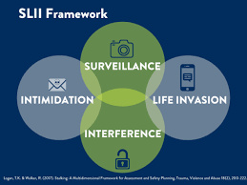
Major Stalking Categories
Surveillance is the most commonly identified stalking tactic and includes watching and gathering information about the victim.
Life Invasion describes ways that the offender is showing up in the victim’s life without the victim’s consent.
Intimidation Many behaviors are intimidating when considered within the totality of stalking behaviors and with the victim and offender relationship and history in mind
Interference Stalkers may interfere in a victim’s life in many ways, affecting everything from the victim’s reputation to their employment and/or physical safety
Notes:
Surveillance looks like: the offender has followed you, watched you, shown up unexpectedly, or gone through your mail or trash.
Life Invasion looks like: the offender has repeatedly initiated unwanted contact with you (for example, repeated phone calls, texts, messages, emails, sent gifts to you or left objects/items for you to find, tried to initiate contact with you or through third parties.
Intimidation looks like: the offender has threatened you directly or indirectly, in-person or online threatened family, friends, pets, or others that you care about, threatened to destroy property, harm pets, or to sabotage you in other ways.
Interference looks like: the offender has significantly and directly interfered with your life, damaged your property or stolen from you, disrupted your professional and/or social life, or caused you to have a serious accident.

Slide 13
WV State Law and Definition of Stalking
Note: In 2020 the word Stalking was inadvertently removed from the state code.
West Virginia Code §61-2-9a: Harassment; penalties; definitions.
Subsection (a)
  Any person who engages in a course of conduct directed at another person with the intent to cause the other person to fear for his or her personal safety, the safety of others, or suffer substantial emotional distress, or causes a third person to so act, is guilty of a misdemeanor and, upon conviction thereof, shall be fined not more than $1,000, confined in jail for not more than six months, or both fined and confined.
Subsection (d)
  A second or subsequent conviction for a violation of subsection (a) or (b) of this section is a felony punishable by imprisonment in a state correctional facility for not less than one year nor more than five years, or fined not less than $3,000 nor more than $10,000, or both fined and imprisoned.

Slide 14

WV State Law and Definition of Stalking
Notwithstanding any provision of this code to the contrary, any person against whom a protective order is in effect pursuant to the provisions of §53-8-7 of this code, who has been previously served with a copy of said order, who commits a violation of the provisions of this section, in which the subject in the protective order is the victim, is guilty of a felony and punishable by imprisonment in a state correctional facility.
Notes:
WV law indicates if one has a protection order, violation of said order will increase imprisonment time, charge, and fine. In fact, this is what helped a survivor finally have her stalker jailed. He violated several protection orders and each time his jail time increased. This was an integral part of her ability to have him removed from her life.

Slide 15
Criminal
What is Stalking?
Traumatic
Dangerous
Stalking is a crime on the federal and state level
Stalking violates Campus Codes under the Clery Act and Title IX
Many victims experience mental health issues
Many victims face general health issues as a result of stress
Many victims face financial loss
Stalking often co-occurs with physical and sexual violence.
Notes:
Criminal: In all 50 States, D.C., and all U.S. Territories, on Tribal Lands, and in the Military Justice System
Traumatic: mental health issues include depression, anxiety, insomnia. Lose time from work: 1 in 8 employed stalking victims lose time from work; Relocate: 1 in 7 stalking victims move
Dangerous: 20% of stalkers use weapons to threaten or harm victims, 76% of intimate partner femicides included stalking in the year prior.

Slide 16
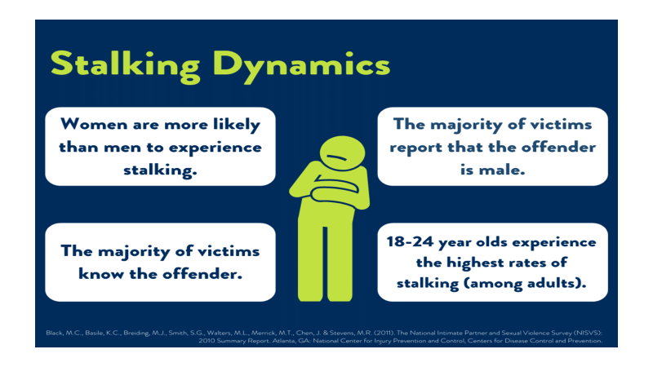

Slide 17
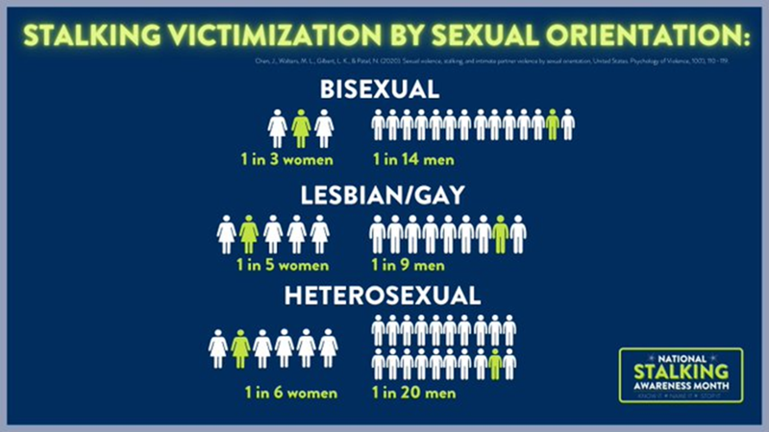

Slide 18
Possible Stalking Behaviors
What are some behaviors that can be considered stalking?
Unwanted Contact (texting, phone calls)
Receiving unwanted or unsolicited emails or letters
Following or spying on a person
Showing up to places without a legitimate reason
Leaving unwanted items, presents, or flowers
Consistently posting information about or spreading rumors about their target

Slide 19

Stalking Behaviors
•Stalking in media often creates a fantasy of stalking that is different than the reality.
•Stalkers are often presented as attractive strangers or secret admirers with good intentions.
•In reality, stalkers are usually known to the victim, intend to cause fear and are likely to become threatening and/or violent.
Notes:
How many of you are familiar with the series, “You”, on Netflix?
In the show, how many and what type of stalking behaviors does Joe engage in?

Slide 20
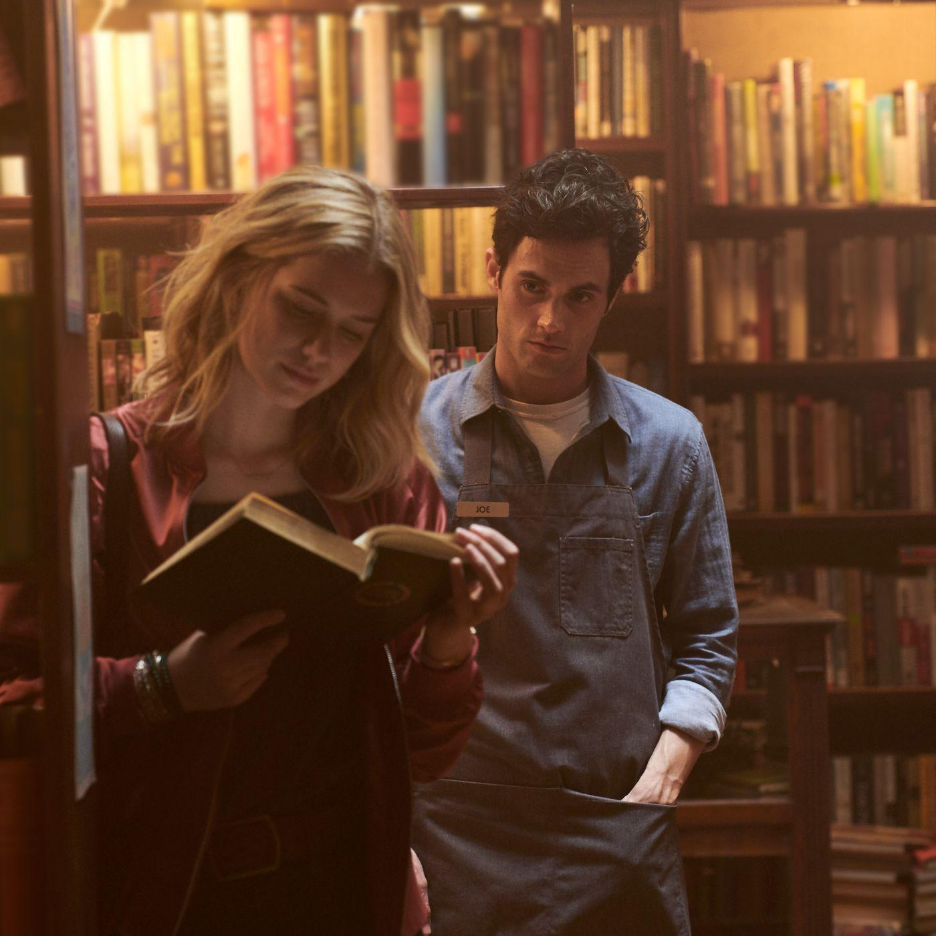
While “You” is fictional and a bit sensationalized, many of the stalking behaviors that Joe engages in are fairly common.
Following, watching through her window, showing up where she is.
Stalking through technology: monitoring texts, messages, GPS.
Stalking through social media: keeping track of her posts, messages, social media presence.
Breaking into her home and stealing her property.
Impersonating a victim online
Mining friends for information
Over half the time, intimate partner stalkers stalk during AND after the relationship.
Notes:
Here we can see some examples of Tech related stalking which we will address later.
This type of media depiction romanticizes the Joe character and people may not realize that stalking is scary and a real issue that actually impacts many people.
As you can see we have addressed mining friends for information, this is called “stalking via proxy”, many stalkers get information about their victims from family, friends, colleagues, and others and/or get those people to engage in stalking behavior unwittingly. Often the victim’s community offers this information without realizing the situation.

Slide 21

Context of Behaviors is Critical to Understanding Stalking Victimization
Does the stalker show up or loiter at the victim’s work or other places the victim frequents?
Does the stalker use technology?
Has the stalker ever forcibly kept the victim from leaving?
Has the victim made significant life changes for safety reasons?
Has the stalker been directly and clearly notified that their actions are unwanted, yet they continue with the behavior?
Notes:
Roses story
You receive a call. A woman is crying and gasping, struggling to speak on the other end. When she finally calms down, she says: “There’s a cup of coffee in my car.Eventually, the victim says:
“She’s here.” It turns out that the caller is a stalking victim who recently relocated. She did not believe that her stalker ex-girlfriend – who has threatened her repeatedly and physically abused her in the past -- knew where she was. When she left for work this morning, there was a cup of coffee in her car with the pet name her ex uses for her on it.

Slide 22
13.5 million
People are stalked in a one-year period in the United States
Smith, S.G., Basile, K.C., & Kresnow, M. (2022). The National Intimate Partner and Sexual Violence Survey (NISVS): 2016/2017 Report on Stalking. Atlanta, GA: National Center for Injury Prevention and Control, Centers for Disease control and Prevention

Slide 23

3
Campus Related Stalking

Slide 24
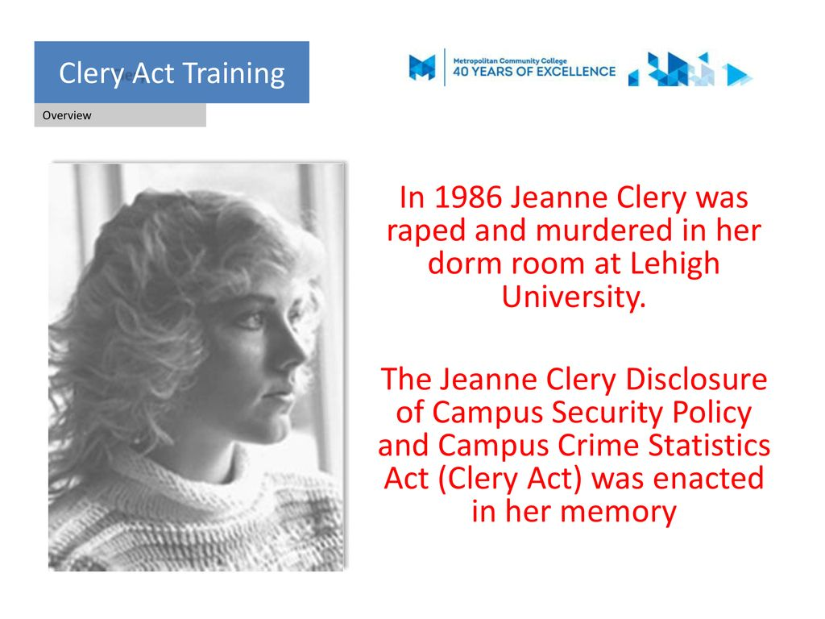
The Clery Act
The Clery Act requires colleges and universities to report campus crime data, support victims of violence, and publicly outline the policies and procedures they have put into place to improve campus safety.
Notes:
Crimes include domestic violence, sexual assault, dating violence, and stalking. When a crime covered by the Clery Act occurs, campus officials are required to evaluate if there is a serious or ongoing threat to the campus community to determine if a timely warning needs to be issued to all staff and students.

Slide 25

What is Title IX ?
TItle IX requires institutions to protect all students, faculty, and staff from sex-based discrimination, a term that includes both sexual harassment and sexual violence. If the administration is made aware of an incident, colleges must take immediate steps to address the issue.
Notes:
Dr. Pendergast is the Title IX coordinator at Concord.

Slide 26

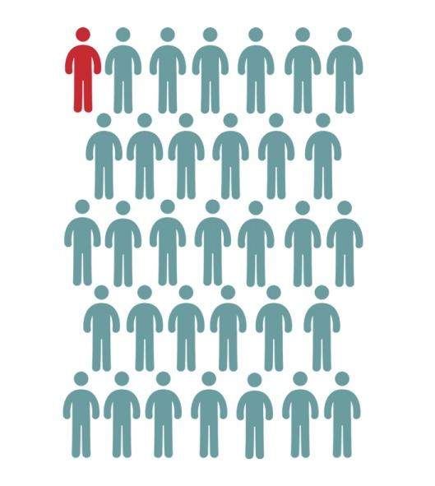
1 in 10
Undergraduate Women
1 in 33
Undergraduate Men
Are Victims of Stalking

Slide 27
College-Specific Dynamics
Students who identify as transgender, non-binary, or gender-queer experience the highest rates of stalking.
Students with disabilities are twice as likely to experience stalking as students without disabilities.
Black and Native American students are over 30% more likely to experience stalking than their counterparts.
Bisexual students, particularly females, experience the highest rates of stalking.
Notes:
Trans stats: 1 in 7 transgender and nonbinary/genderqueer students reported experiencing stalking, compared to 1 in 17 of all students; Transgender and nonbinary/genderqueer student victims were more likely than cisgender student victims to contact a program or resource for help
Minority students are nearly twice as likely to be stalked by an acquaintance or a stranger than a former partner.

Slide 28
College Student Stalking Victimization
Between 6-39% of college students reported being stalked since the first year of college
43% of college stalking victims who meet the legal criteria of stalking do not identify their experience as stalking
92% of students tell friends or family while only 29% contact a program or resource for help
45% of students reported unwanted voice or text messages
44% reported unwanted emails or social media messages
37% reported being approached or the stalker showing up at places the victim was at

Slide 29
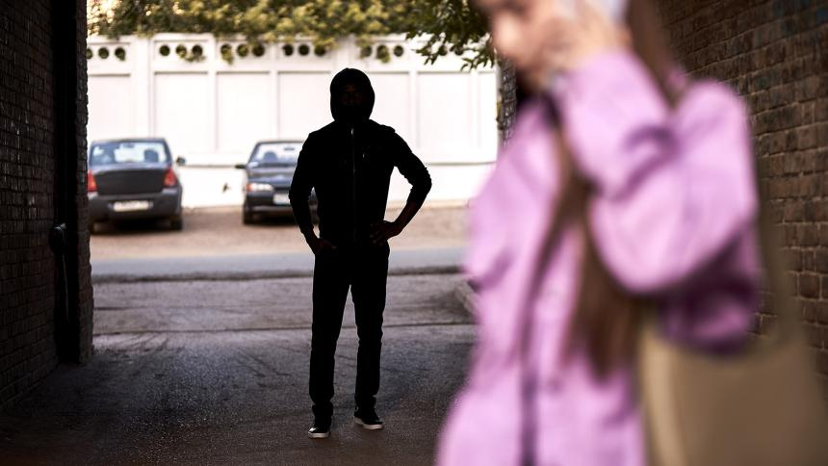
School-Related Impacts for Stalking Victims
• Difficulty concentrating in class, on assignments, and during exams
• Missing meetings and extra-curricular activities
• Dropping classes
• Lower grades
• Considering dropping out of school
• Changing living situation, like moving out of dorms

Slide 30
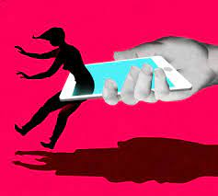
4
Tech Related Stalking

Slide 31
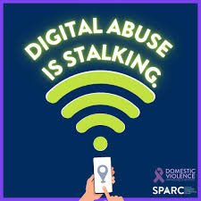
What is Tech-Facilitated Stalking
Tech-Facilitated Stalking involves using technology and digital devices to stalk, harass, surveil, and control you.
Cyberstalking refers to the use of the Internet, e-mail, or other telecommunication technologies to harass or stalk another person. It is not the mere annoyance of unsolicited e-mail. It is methodical, deliberate, and persistent.
Notes:
Through technology and our use of social media, we can quickly and easily connect with other people. However, typical activities such as tweeting, updating a Facebook status, or using a phone’s GPS to find local restaurants can all be misused by abusers to stalk, harass, surveil, and control you. Mobile devices include call records, texts, web surfing and physical location histories. Many social media apps also track a user’s friends, conversations and location.The goal of the technology abuse can be to track or control you, to isolate you from supportive friends and family, or to damage a your credibility or work-life.

Slide 32

Digital Evidence
When it comes to technology-facilitated abuse, preserving evidence is CRITICAL.
Coordinate with law enforcement and prosecutors early on, if you feel safe to do so. An advocate at Family Refuge Center can help you every step of the way on this process.
Save ALL text messages, photos, videos, voice messages, screenshots from phones and laptops, and printed emails with the header expanded.
Notes:
As an advocate I can also help victims to document what the stalker is doing and the victim is experiencing so that a record of stalking incidents and behaviors is established. If you choose to engage law enforcement, this documentation can be used to help begin an investigation. Though our gut reaction is to hit ‘delete,’ we need to consider documenting what’s happening on the device before removing it.

Slide 33

What do I do if it’s happening to me?
Tell someone
Block the perpetrator
Make social media profiles private
Keep them from seeing where you are in real time
Report the perpetrator
Document ALL stalking behavior
Change your passwords
Contact local law enforcement
Call 911
Notes:
Tell: Tell your friends, family, or any trusted adult that this person is stalking you. Ask them for help. Even if you feel like the situation is embarrassing, and you’d rather keep it private, DON’T. This will enable the stalker to continue. Support from others is usually helpful to figure out how to stop the stalking and protect you from harm, even though many victims of stalking feel ashamed about the situation.
Block: Most stalkers won’t listen when you ask them to stop contacting you. That’s why it’s essential, as a precautionary measure, to block their phone number and email address to prevent them from trying to reach you again. You’ll also need to block them on social media.
Social Media Profiles: Stalkers are resourceful; they could keep creating new email addresses and social media profiles just to gain access to you and/or what you’re posting. If your profile is public, your stalker can easily continue seeing your pictures, status, and other personal information. While making your posts private does limit your ability to share with a higher audience, and people who aren’t your “friends”, it immediately keeps you safer.
Real time: Don’t post photos or videos on social media that show your exact location at that point in time. Even if your profile is already on private, your stalker could easily figure out where you are by using one of your “friend’s” accounts. Additionally, turn off Location Services on your smartphone.
Report: Stalking falls under the “harassment” category of most social media platforms. This means you can report this person on whichever platform they are using to contact you.
Change: If the stalker used to be a close friend or partner, they might know the password (or two) to your phone, laptop, email, social media, etc. Change these passwords immediately, and make them very hard to guess.
Contact: police will give you a number of options as to what to do. Bring whatever evidence you have of the stalking: screenshots of text messages, tangible notes/gifts that they sent you, screenshots of call logs, printed email messages, etc. Having documented evidence of the stalking will help you receive a protection order if necessary.
Call 911: If the stalker is threatening to harm you – in person or online – then you need to get help as soon as possible. Call 911 and report what’s going on. You can also call 911 if the stalker is threatening to kill themselves if you don’t “call them back”/”keep talking to them”/”return their advances”. Even you think the stalker is just “being manipulative,” don’t hesitate to report them to emergency services.

Slide 34
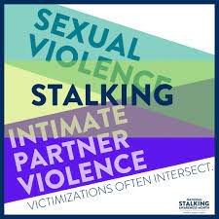
5
Intersection Between Stalking and Sexual Violence

Slide 35
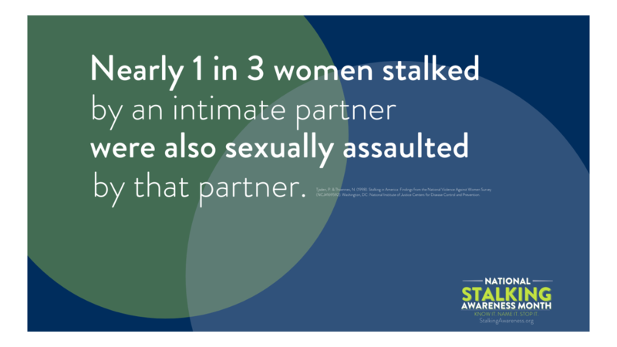

Slide 36
Intersection of Sexual Violence and Stalking
A stalker may:
Threaten to sexually assault the victim
Sexually assault the victim
Attempt to get someone else to sexually assault the victim
Notes:
Sexual assault offenders often groom their victims. The grooming process involves selecting a target, developing trust, and building a relationship. This could be an unsuspecting college freshman being targeted, maybe a person with a cognitive disability being taken advantage of, or someone you meet on an internet dating site. A unique aspect of the grooming process is that it occurs over time, so a victim’s sense of fear or that something may not feel ‘right’ is diminished. Keep in mind that fear doesn’t have to be associated with a single incident related to stalking – it can be the culmination of the combined behaviors.
Stalking can be part of that grooming process in a planned sexual assault as the offender follows the target, gathering information about patterns of behavior.

Slide 37
Using Stalking to Groom for Sexual Violence
Perpetrators of stalking will:
  Research and identify vulnerable victims
  Establish a relationship and build trust
  Meeting in person and isolate the victim
  Coerce the victim into sexual acts
  Contact the victim after the sexual assault

Slide 38
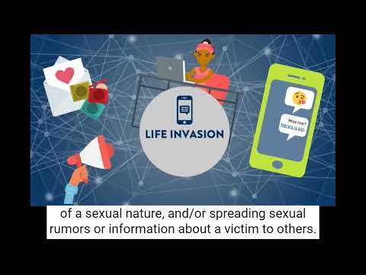
Stalking and Sexual Violence

Slide 39

6
Wrap Up!

Slide 40

Early Intervention is Key
Stalking is one of the few crimes where early intervention can prevent violence and death.
29 % of stalking victims report to law enforcement
21% of stalking victims seek victim services
Fewer than 29 % of student stalking victims seek services on campus
One study showed less than 8 % disclosed to formal support
Notes:
Why do you think a stalking victim wouldn’t call law enforcement or seek victim services? What would be keeping them from reporting?

Slide 41
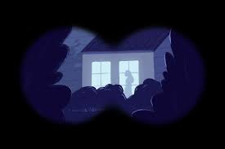
Stalking Kits
Log book and Pen
Nitrile Gloves
Paper Bag (for collection of evidence)
Pepper Spray
Key Chain Alarm/Light
Safety Tips
Information Sheet
Notes:
Tell students where kits can be found and explain contents of kit

Slide 42
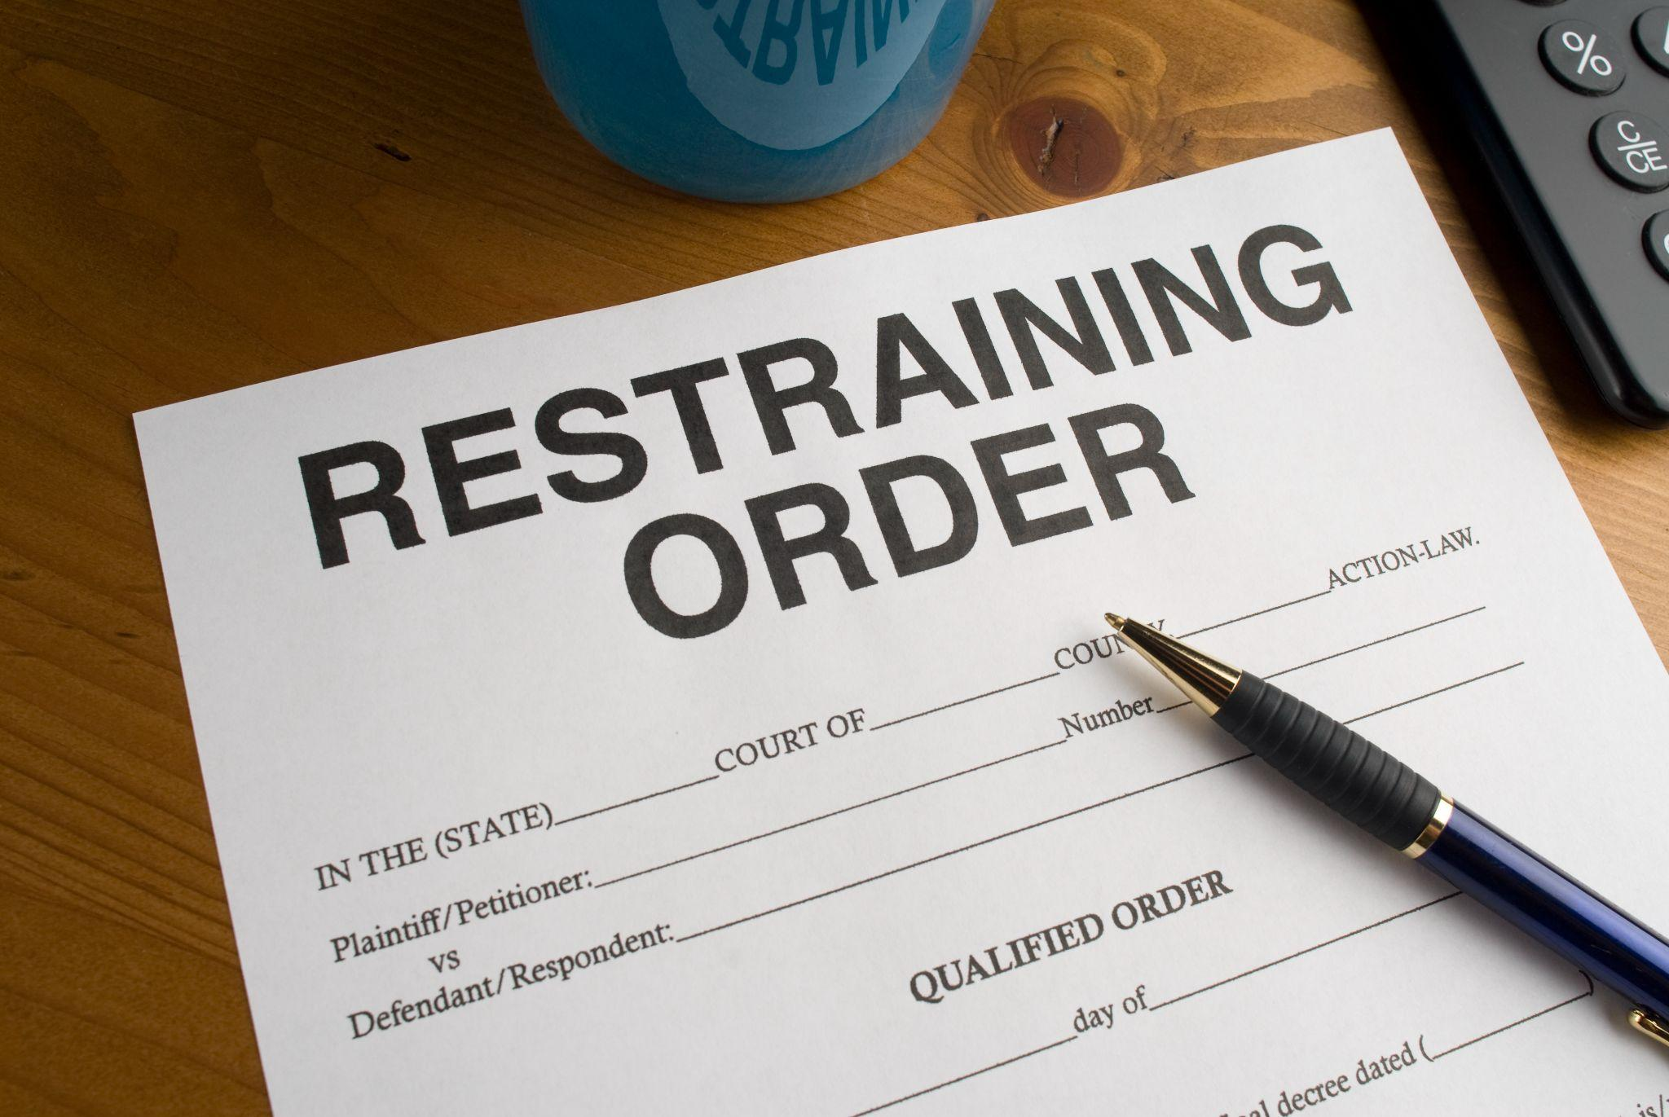
Protection Orders
Domestic Violence Protection Orders:
  Seeking protection from a family member, a household member, someone you have a family relationship with or someone with whom you have or had a romantic relationship.
Personal Safety Orders:
  Used if you are seeking protection from anyone who does not fit the above categories, i.e. a stranger.
Notes:
DVPO: 90 days, 180 days, 1 year.
PSO: Up to 2 years.

Slide 43

What do I do if it’s happening to someone I know?
Recognize that stalking is a pattern of conduct
Realize that stalking victims may maintain contact with their offenders to keep themselves (or loved ones) safe.
Encourage your friend to maintain a detailed log of all contacts with the stalker and save any evidence (e.g. notes, gifts, objects, photos, printed emails or social media posts and messages, or voicemails) as record of the stalking behavior.
Seek support and information for you and your friend.
Continue your support during the recovery process.
Notes:
A stalking victim’s level of fear and need may vary and change based on the stalker’s behaviors.
Encourage your friend to work with a professional to develop a safety plan and urge law enforcement involvement.

Slide 44

Who to report to on campus
Resident Director or Resident Assistants.
Title IX Coordinator:
  Dr. Joan Pendergast
Anyone on campus in a leadership role that you trust
and feel comfortable with.
Concord University Office of Public Safety

Slide 45
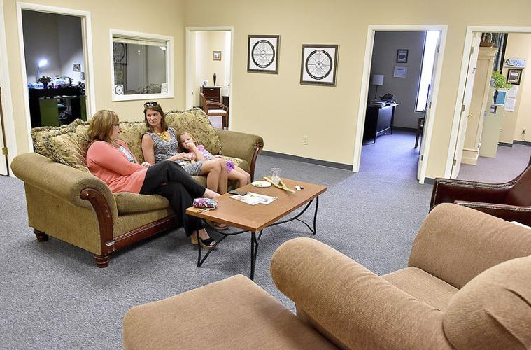
Who to Report to in the Community
Family Refuge Center
serrellg@familyrefugecenter.org
304-800-2892 ext 200
24/7 crisis line 304-645-6334
Mercer County Sheriff’s Department
304-487-8364
Princeton Police Department
304-487-5000
WV State Police-Princeton Detachment
304-425-2101
Notes:
An advocate with the Family Refuge Center will assist and accompany you in a confidential setting, providing you with the tools to document behaviors and resources to guide you through the process. We offer accompaniment with law enforcement as well if you choose to report the stalking, we will be with you every step of the way. If you feel that you are being stalked reach out to an advocate at our center or to local law enforcement.

Slide 46

Questions?
Notes:
Finish flyer about contacts on campus and off

